Slide 1
KingsGuard
Neha Singh
Anjali Rani
Shivam Kumar
Atul Aditya
12/15/2019

Slide 2

Problem Statement
DEFINE
THE PROBLEM
Problem Statement 1: One app for all purpose whether the user is in a monument, shopping mall or hotel chains and many more
Problem Statement 2: Least expensive voice to text and text to voice conversion app, great replacement for all expensive hardware like echo, event affordable to small businesses

Slide 3

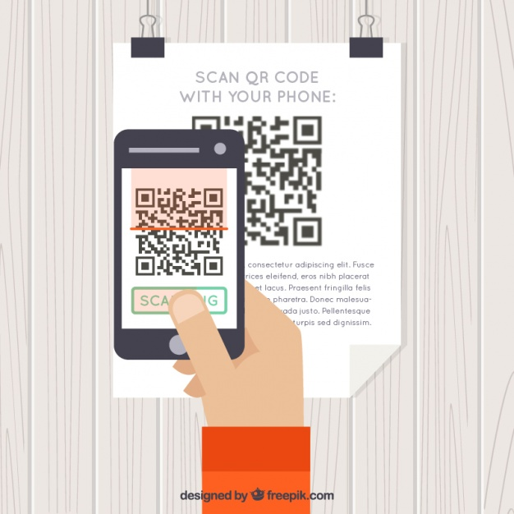
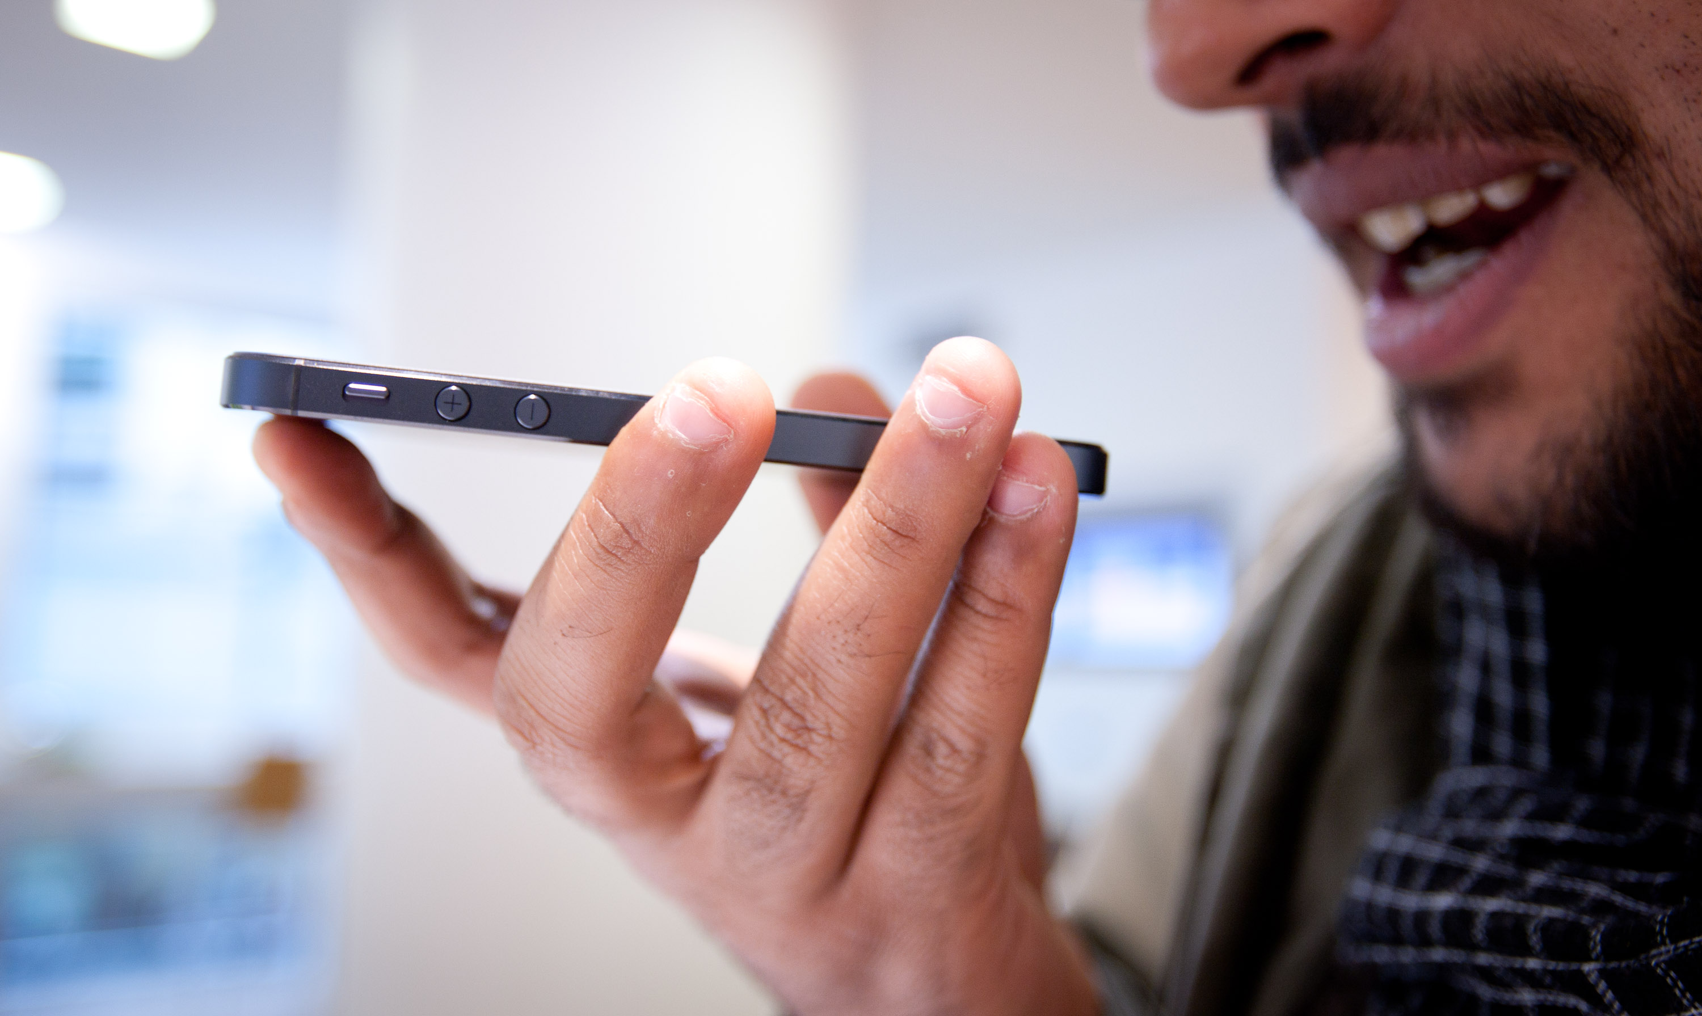


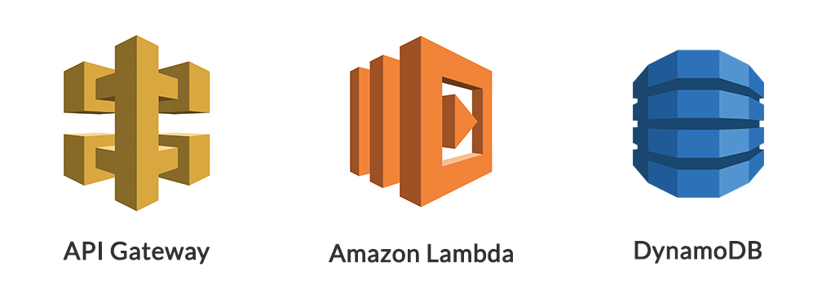
User workflow and technology stack
User visits a place (monument, mall, zoo,hotel)
Scans the QR code
Asks questions to receptionist
Android Receptionist
App converts voice to text
Parser : Convert text questions to tags and finds the most appropriate question by percentage calculation
Finds the most appropriate answer to the question : Stores all the answers
Technology Stack
Android App written in Kotlin
Parser written in Node.js
Serverless Cloud computing : AWS: API Gateway , Amazon Lambda , Dynamodb
Speaks the answer to the user

Slide 4
Business workflow and technology stack
Registration/ login Screen
Registration Screen
Welcome screen
Question Answer Screen
Technology Stack
Web App written in Angular 8
Serverless Cloud computing : AWS: API Gateway , Amazon Lambda , Dynamodb

Slide 5
Limitations
Currently we have to open our app and ask the receptionist the voice command.
Future Scope
- Nature language processing will be enhanced with time.
- Extending the parser to larger businesses

Slide 6


Slide 7

Thank You

